Slide 1
HTML extra Tags
ZhuHua

Slide 2
The Evolution of HTML
HyperTe t Markup Language (HTML) was initially developed by Sir Tim Berners-Lee in late 1991. It was designed as a standard language for creating and formatting documents on the World Wide Web. All the web pages on the internet are made from HTML.
From 1990 to 1995, HTML underwent changes and e tensions, initially at CERN and then at the IETF. The World Wide Web Consortium (W3C) became the new home for HTML development.
With the introduction of new versions of HTML, support for additional features was added, and the user e perience was enhanced.

Slide 3
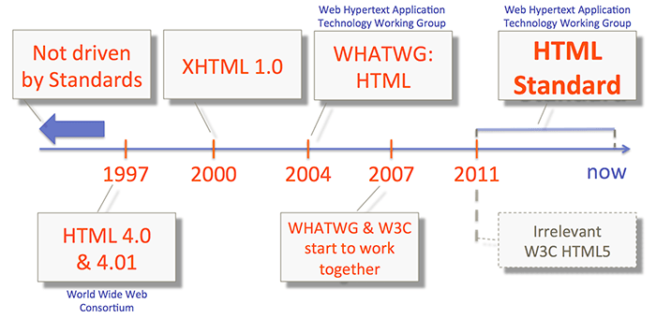
The Evolution of HTML

Slide 4
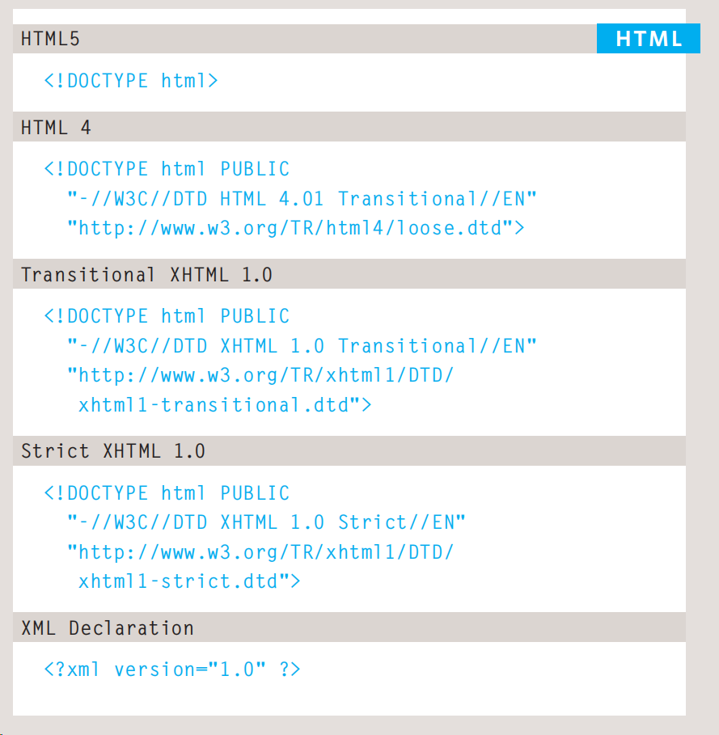
DOCTYPE

Slide 5
HTML5
HTML 5 was officially introduced by the W3C in October 2014. This version of the markup language was a big step forward compared to all of its predecessors because it brought forth a host of new features to enrich the web e perience:
A strong focus on multimedia files
Advanced semantic elements
A simpler synta
Responsive markup practices
The last entry was particularly important for the growing number of users who accessed the Web through different types of devices. Though fairly old from the tech perspective, HTML 5 is still the most commonly used markup language among web developers.

Slide 6
Comments in HTML
If you want to add a comment to your code that will not be visible in the user's browser, you can add the te t between these characters:
<!-- comment goes here -->
It is a good idea to add comments to your code because, no matter how familiar you are with the page at the time of writing it, when you come back to it later (or if someone else needs to look at the code), comments will make it much easier to understand.

Slide 7
ID Attribute
Every HTML element can carry the id attribute. It is used to uniquely identify that element from other elements on the page.
Its value should start with a letter or an underscore (not a number or any other character).
It is important that no two elements on the same page have the same value for their id attributes (otherwise the value is no longer unique).
As you will see when you come to look at CSS in the ne t section, giving an element a unique identity allows you to style it differently than any other instance of the same element on the page.

Slide 8
class Attribute
Every HTML element can also carry a class attribute.
Sometimes, rather than uniquely identifying one element within a document, you will want a way to identify several elements as being different from the other elements on the page.
For e ample, you might have some paragraphs of te t that contain information that is more important than others and want to distinguish these elements, or you might want to differentiate between links that point to other pages on your own site and links that point to e ternal sites.
To do this you can use the class attribute. Its value should describe the class it belongs to. In the e ample on the left, key paragraphs have a class attribute whose value is important.

Slide 9
Block Elements & Inline Elements
Some elements will always appear to start on a new line in the browser window. These are known as block level elements. E amples of block elements are <h1>, <p>, <ul>, and <li>.
Some elements will always appear to continue on the same line as their neighbouring elements. These are known as inline elements. E amples of inline elements are <a>, <b>, <em>, and <img>.

Slide 10
Grouping Text & Elements In a Block
The <div> element allows you to group a set of elements together in one block-level bo .
For e ample, you might create a <div> element to contain all of the elements for the header of your site (the logo and the navigation), or you might create a <div> element to contain comments from visitors.

Slide 11
Grouping Text & Elements Inline
The <span> element acts like an inline equivalent of the <div> element.
It is used to either:
1. Contain a section of text where there is no other suitable element to differentiate it from its surrounding text
2. Contain a number of inline elements The most common reason why people use <span> elements is so that they can control the appearance of the content of these elements using CSS.

Slide 12
IFrames
An iframe is like a little window that has been cut into your page — and in that window you can see another page.
The term iframe is an abbreviation of inline frame. One common use of iframes (that you may have seen on various websites) is to embed a Google Map into a page.
The content of the iframe can be any html page (either located on the same server or anywhere else on the web).
<iframe src="https://www.baidu.com/" title="Baidu" height="600p " width="600p ">

Slide 13
Information About Your Pages
<meta> Defines metadata about an HTML document
<meta> tags always go inside the <head> element, and are typically used to specify character set, page description, keywords, author of the document, and viewport settings.

Slide 14
Information About Your Pages
Define keywords for search engines:
<meta name="keywords" content="HTML, CSS, JavaScript">
Define a description of your web page:
<meta name="description" content="Free Web tutorials for HTML and CSS">
Define the author of a page:
<meta name="author" content="John Doe">
Refresh document every 30 seconds:
<meta http-equiv="refresh" content="30">
Setting the viewport to make your website look good on all devices:
<meta name="viewport" content="width=device-width, initial-scale=1.0">

Slide 15
Escape Characters
There are some characters that are used in and reserved by HTML code. (For e ample, the left and right angled brackets.)
Therefore, if you want these characters to appear on your page you need to use what are termed "escape" characters (also known as escape codes or entity references). For e ample, to write a left angled bracket, you can use either &lt; or &#60;. For an ampersand, you can use either &amp; or &#38;.
There are also special codes that can be used to show symbols such as copyright and trademark, currency symbols, mathematical characters, and some punctuation marks. For e ample, if you want to include a copyright symbol on a web page you can use either &copy; or &#169;.

Slide 16
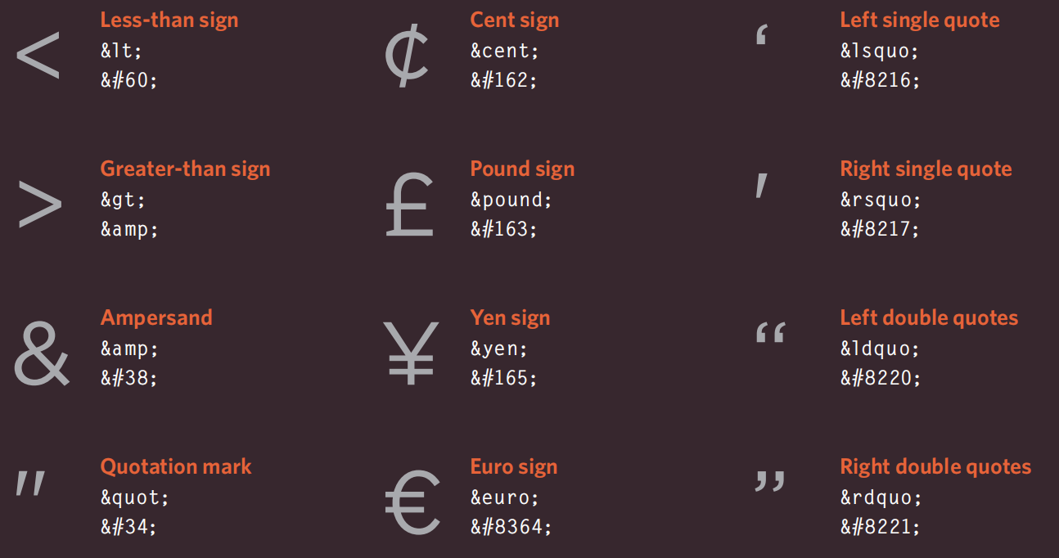
Escape Characters

Slide 17
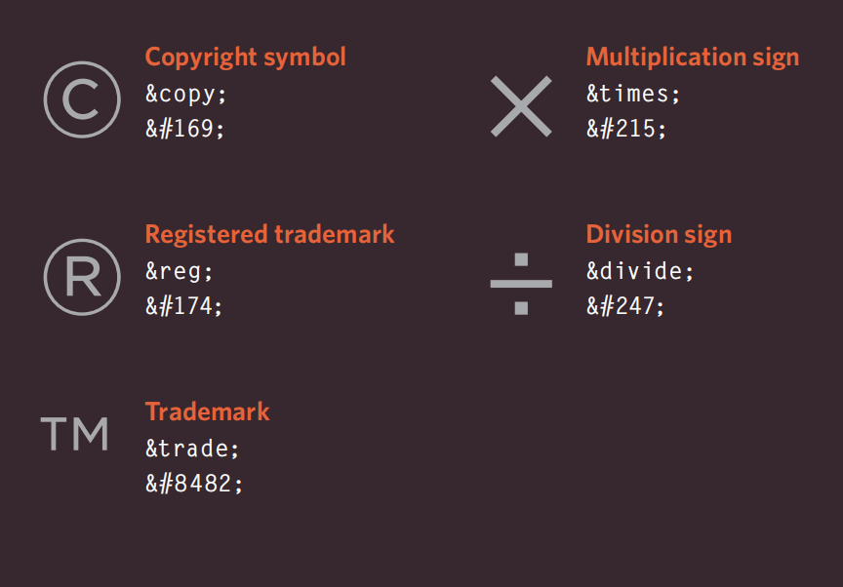
Escape Characters

Slide 18
Summary
DOCTYPES tell browsers which version of HTML you are using.
You can add comments to your code between the <!-- and --> markers.
The id and class attributes allow you to identify particular elements.
The <div> and <span> elements allow you to group block-level and inline elements together.
<iframes> cut windows into your web pages through which other pages can be displayed.
The <meta> tag allows you to supply all kinds of information about your web page.
Escape characters are used to include special characters in your pages such as <, >, and ©

Slide 19
Questions？
You want a hyperlink to open in a new browser tab when a user clicks on it. Which attribute and value should you add to the <a> tag to achieve this?
<-- This is a comment -->
<## This is a comment ##>
<--> This is a comment </-->
<!-- This is a comment -->

Slide 20
Questions？
You want a hyperlink to open in a new browser tab when a user clicks on it. Which attribute and value should you add to the <a> tag to achieve this?
<-- This is a comment -->
<## This is a comment ##>
<--> This is a comment </-->
<!-- This is a comment -->

